Slide 1
Who was better?
Michael Jordan
Or
Shaq
Rematch
Taylor Kerns, Joshua Robles, Kiele Allen • 6/16/2021

Slide 2
Overview
Extraction
Transformation
Load

Slide 3
Who won more games? Who scored more points? Who was better at assists? Who was better at free throws?
Previous Analysis
SHAQ
JORDAN
JORDAN JORDAN

Slide 4
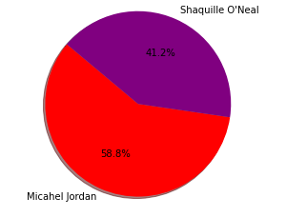
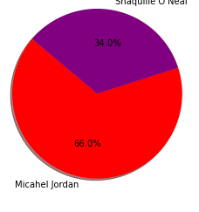
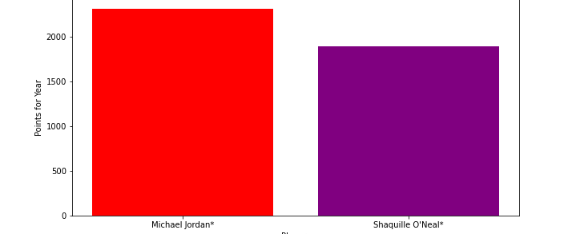
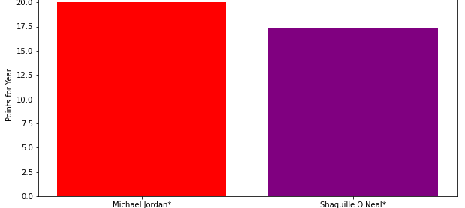
1st Season vs 15th Season
Free
Throws
Points
Per
Year

Slide 5
Who won more games? Who scored more points?* Who was better at assists? Who was better at free throws?*
Our Analysis
SHAQ
JORDAN
JORDAN JORDAN
* See previous slide for visual comparison

Slide 6
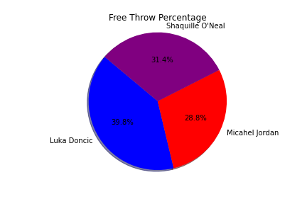
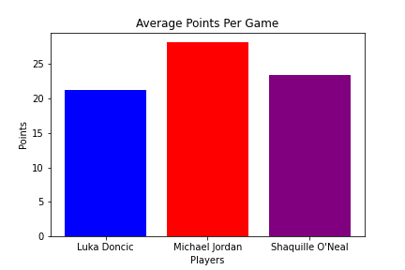
Overtime

